Slide 1
Innovate, Collaborate, Embrace
Costeijn Kuhlmann
Cloud Software Engineer
costeijnk@infosupport.com

Slide 2
Open-source, cross-platform, multiple devices your world has changed…. Microsoft is coming too.

Slide 3
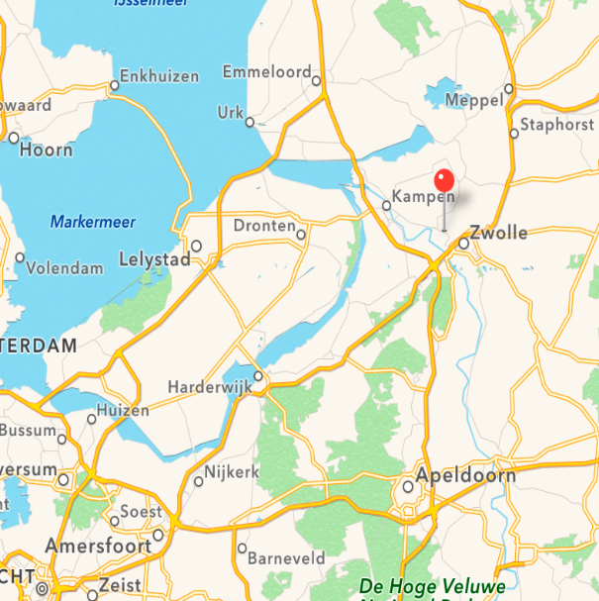

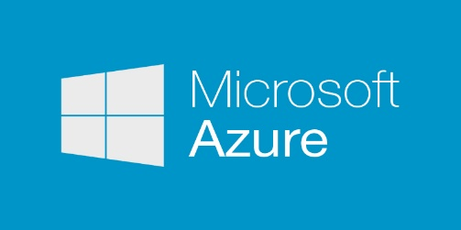

Who am I?
Costeijn Kuhlmann
27
Zwolle
(Cloud) Software Engineer at Info Support
Coder by day, Barista by night

Slide 4
Info Support
Founded in 1986
Netherlands and Belgium
>350 employees
Professional development center
Products
Endeavour
KnowNow

Slide 5
Topics
Vision and trends (10)
.NET 2015 (20)
Containers (20)
ASP.NET 5 (20)
C# 6 (10)

Slide 6
Topics
Vision and trends (10)
.NET 2015 (20)
Containers (20)
ASP.NET 5 (20)
C# 6 (10)

Slide 7
Vision and trends
Windows 10 everywhere
All the apps become Windows apps
The future of Office: Sharing and apps
Azure Pack: Azure for your datacenter
Azure Service Fabric: platform for hyperscale microservices

Slide 9
Topics
Vision and trends (10)
.NET 2015 (20)
Containers (20)
ASP.NET 5 (20)
C# 6 (10)

Slide 10
History of .NET
Windows Desktop
Windows Store
Windows Phone
App
Model
App
Model
App
Model
Framework
Framework
Framework
Runtime
Runtime
Runtime

Slide 11




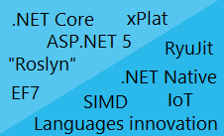



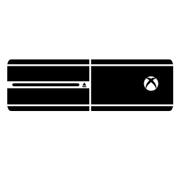



The road ahead for .NET
ASP.NET 5
.NET Core
.NET Innovation
Open Source
Cross-Platform
Bron: Microsoft

Slide 12

.NET 2015
WPF
Windows Forms
ASP.NET
(4 & 5)
ASP.NET 5
Universal
Windows Apps
.NET Framework 4.6
.NET Core 5
CoreCLR
.NET Native
Fully-featured and integrated
.NET libraries and runtime for Windows
Modular and optimized
.NET libraries and runtimes
Shared
Runtime components
Libraries
Compilers
RyuJIT + SIMD
Garbage Collector
Base class libraries
NuGet packages
.NET Compiler Platform (Roslyn)
Languages innovation

Slide 13
.NET Framework 4.6
Highly compatible, in-place replacement for .NET 4, 4.5, 4.5.1, and 4.5.2
Full support of any .NET API and Libraries in the market
WPF is the platform of choice for desktop application development
ASP.NET 5 is also supported running on top of .NET 4.6
.NET 4.6 also gets the investment on new compilers, new Jit, and languages innovation

Slide 14
.NET Core 5
Cloud first, modular runtime and library that includes a subset of the .NET Framework.
Run side-by-side with your App.
Feature complete on Windows, in-progress builds for OSX and Linux.
Contains the Core-CLR and CoreFX.
All packaged through individual NuGet packages.
- System.Collections
- System.Console
Windows Store App Model
ASP.NET 5
App Model
Unified BCL
Runtime adaption layer
.NET Native
Runtime
CoreCLR

Slide 15
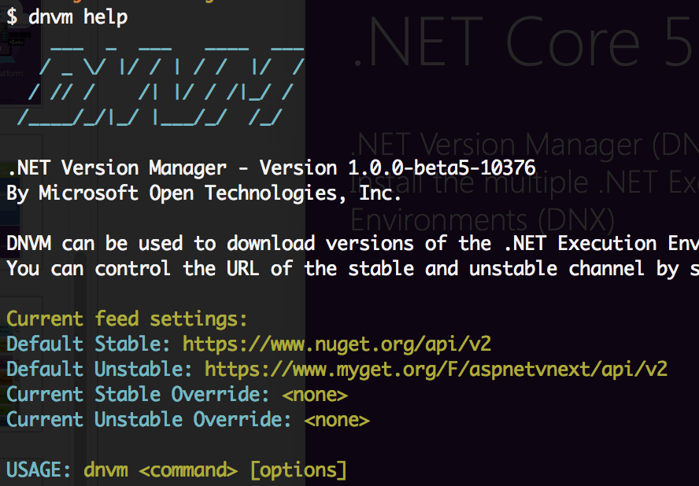
.NET Core 5
.NET Version Manager (DNVM)
Install multiple .NET Execution Environments
. NET Execution Environment (DNX)
SDK and runtime environment that has everything you need to build and run .NET applications for Windows, Mac and Linux.
.NET Development Utility (DNU)
Build, Restore and publish your project

Slide 16
.NET Compiler Platform (“Roslyn”)
C#, VB
Source code
.exe/.dil
IL assemblies
FROM
Isolated/closed compilers
Hard to extend dev experience
Established .NET compilers
Open platform for developers
TO
API: open platform
Rich IDE experiences/refactoring
Code analysis
Custom diagnostics
Open Source compilers
C#, VB
Source code
.exe/.dil
IL assemblies
.NET Compilers Platform
(a.k.a. ROSLYN)

Slide 17
.NET Compiler Platform (“Roslyn”)
FROM
Isolated/closed compilers
Hard to extend dev experience
TO
API: open platform
Rich IDE experiences/refactoring
Code analysis
Custom diagnostics
Open Source compilers

Slide 18
But what about Mono?
Mono is a very popular platform for mobile .NET development on iOS and Android
It enjoys strong support from both the open source community as well Xamarin, Unity, etc.
While great for mobile scenarios, Mono wasn’t designed for server/cloud production-grade scenarios, i.e.
High throughput
Scale up/out
Ongoing collaboration on GitHub with the Mono community

Slide 19



How do I get the bits?
.NET Core already installed as part of VS2015 RC
Download & install tar file
Download & install tar file
Use Homebrew formula on GitHub
Create VM on Azure Marketplace
Use Dockerfile on Docker Hub (coming)
Clone repo on GitHub and build from source (advanced)

Slide 20
DEMO: .NET Core 5 on Mac OSX

Slide 21
Topics
Vision and trends (10)
.NET 2015 (20)
Containers (20)
ASP.NET 5 (20)
C# 6 (10)

Slide 22
Virtual Machines
Emulates compute environment
Requires full OS
Assigned resources (CPU, Memory, HD, etc)
Runs on a hypervisor(Hyper-V, VMWare, KVM)
APP A
APP B
BIN/LIBS
BIN/LIBS
GUEST OS
GUEST OS
HYPERVISOR
HOST OS
SERVER

Slide 23
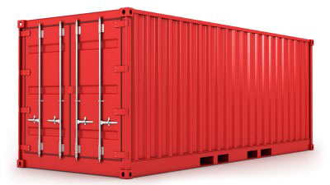
Containers
Lightweight Virtual Machine
A unit of software delivery
Docker is the most popular container technology
APP A
APP B
BIN/LIBS
BIN/LIBS
DOCKER ENGINE
HOST OS
SERVER

Slide 24
Docker
Open-source engine that automates the deployment of any application as a portable, self-sufficient container that can run almost anywhere (on Linux)
Docker containers are created by using images. An image can be basic, with nothing but the operating-system fundamentals.
Registries hold images. Either local or public (Docker Hub)

Slide 25
Windows Server Container
Windows Server containers provide applications an isolated, portable and resource controlled operating environment.
By sharing the same kernel and other key system components, containers exhibit rapid startup times and reduced resource overhead.

Slide 26









Windows Container Images
Container Run-Times
Container Management
Docker
Hyper-V Container
PowerShell
Application
Framework
Application
Framework
Others
Windows Server Container
Write once, deploy anywhere

Slide 27
DEMO: Running MongoDB in a container

Slide 28
Topics
Vision and trends (10)
.NET 2015 (20)
Containers (20)
ASP.NET 5 (20)
C# 6 (10)

Slide 29


ASP.NET 5 and the Modern Web
Totally Modular
Faster Development Cycle
Seamless transition from on-premises to cloud
Choose your Editors
and Tools
Open Source with Contributions
OSS
Cross-Platform
Fast

Slide 30
ASP.NET 5
ASP.NET on Windows, OSX and Linux
No More Web Forms (and System.Web)
Tag Helpers (<form asp-controller=”Products” />)
ViewComponents
Unified Controller
DI Framework

Slide 31
How does ASP.NET fit in the whole story?
ASP.NET 5
Unified framework for MVC, Web API and SignalR
.NET Framework 6
Full framework for any scenario
.NET CORE 5
Small runtime, optimized for cloud

Slide 32
Creating an ASP.NET 5 App in Visual Studio and deploy it to Docker

Slide 33
Topics
Vision and trends (10)
.NET 2015 (20)
Containers (20)
ASP.NET 5 (20)
C# 6.0 (10)

Slide 34
Confirmed in C# 6.0
Initializers in Auto-properties
Static Using
String interpolation
await in catch and finally
Null conditional operator
nameof expression
Use of IEnumerable<> instead of params[]

Slide 35
The end…

